Slide 1
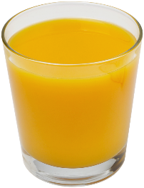
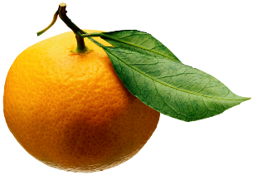
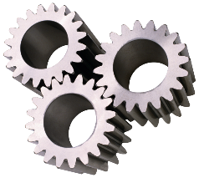
Analysis of Algorithms
Input
Algorithm
Output

Slide 2
How fast is your algorithm?
Low memory usage?
Small amount of time measured on a stopwatch?
Low power consumption?

Slide 3
Running Time
Most algorithms transform input objects into output objects.
The running time of an algorithm typically grows with the input size.
Average case time is often difficult to determine.
We focus on the worst case running time.
Easier to analyze
Crucial to applications such as games, finance and robotics

Slide 4
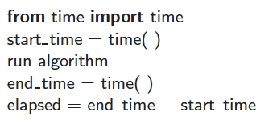
Experimental Studies
Write a program implementing the algorithm
Run the program with inputs of varying size and composition, noting the time needed:
Plot the results

Slide 5

Limitations of Experiments
It is necessary to implement the algorithm, which may be difficult
Results may not be indicative of the running time on other inputs not included in the experiment.
In order to compare two algorithms, the same hardware and software environments must be used

Slide 6
Theoretical Analysis
Uses a high-level description of the algorithm instead of an implementation
Characterizes running time as a function of the input size, n.
Takes into account all possible inputs
Allows us to evaluate the speed of an algorithm independent of the hardware/software environment

Slide 7
The Random Access Machine (RAM) Model
A CPU
An potentially unbounded bank of memory cells, each of which can hold an arbitrary number or character
2
1
0
Memory cells are numbered and accessing any cell in memory takes unit time.

Slide 8
Elementary Operations
Algorithmic “time” is measured in elementary operations
Math (+, -, *, /)
Comparisons ( ==, >, <=, ...)
Function calls and value returns
Variable assignment
Variable increment or decrement
Array allocation
Creating a new object (may have elementary ops too!)
In practice, all of these operations take different amounts of time
For the purpose of algorithm analysis, we assume each of these operations takes the same time: “1 operation”

Slide 9
Elementary Operations
Basic computations performed by an algorithm
Largely independent from the programming language
Exact definition not important (we will see why later)
Assumed to take a constant amount of time in the RAM model
Examples:
Evaluating an expression
Assigning a value to a variable
Indexing into an array
Calling a method
Returning from a method

Slide 10
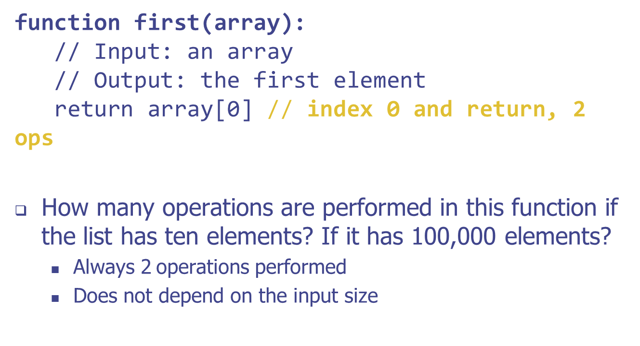
Example: Constant Running Time

Slide 11
Example: Constant Running Time

Slide 12
Example: Linear Running Time
def argmax(array): // Input: an array // Output: the index of the maximum value index = 0 // assignment, 1 op for i in range(len(array))://1 + 1 op per loop i+=1 i<len(array)
if array[i] > array[index]://3 ops per loop
index = i // 1 op per loop, sometimes return index // 1 op
How many operations if the list has 10 elements? 100,000 elements?
Varies proportionally to the size of the input list: 6n + 2
We’ll be in the for loop longer and longer as the input list grows
If we were to plot, the runtime would increase linearly

Slide 13
Estimating Running Time
Algorithm argmax executes 6n + 2 primitive operations in the worst case, 5n + 2 in the best case. Define:
a = Time taken by the fastest primitive operation
b = Time taken by the slowest primitive operation
Let T(n) be worst-case time of argmax. Then a (5n + 2) ≤ T(n) ≤ b(6n + 2)
Hence, the running time T(n) is bounded by two linear functions.

Slide 14
Growth Rate of Running Time
Changing the hardware/ software environment
Affects T(n) by a constant factor, but
Does not alter the growth rate of T(n)
The linear growth rate of the running time T(n) is an intrinsic property of algorithm argmax
Notes:
The growth rate describes how the runtime will increase as the input size grows.

Slide 15
Example: Quadratic Running Time
def possible_products(array): // Input: an array // Output: a list of all possible products // between any two elements in the list products = [] // make an empty list, 1 op for i in range(len(array)): // 1+1=2 op per loop for j in range(len(array)): // 1+1=2 op per loop per loop products.append(array[i] * array[j]) // 4 ops per loop per loop return products // 1 op
Requires about 6n² + 2n + 2 operations (okay to approximate!)
If we were to plot this, the number of operations executed grows quadratically!
Consider adding one element to the list: the added element must be multiplied with every other element in the list
Notice that the linear algorithm on the slide #14 had only one for loop, while this quadratic one has two for loops, nested. What would be the highest-degree term (in number of operations) if there were three nested loops?

Slide 16
Some Common Computing Times
log₂n | n | n log₂n | n² | 2^{n}
1 | 2 | 2 | 4 | 4
2 | 4 | 8 | 16 | 16
3 | 8 | 24 | 64 | 256
4 | 16 | 64 | 256 | 65,536
5 | 32 | 160 | 1,024 | 4,294,967,296
6 | 64 | 384 | 4,096 | 1.84 × 10¹⁹
7 | 128 | 896 | 16,384 | 3.40 × 10³⁸
8 | 256 | 2,048 | 65,536 | 1.16 × 10⁷⁷
9 | 512 | 4,608 | 262,144 | 1.34 × 10¹⁵⁴
10 | 1,024 | 10,240 | 1,048,576 | 1.80 × 10³⁰⁸

Slide 17
Why Growth Rate Matters
Slide by Matt Stallmann included with permission.
if runtime is... | time for n + 1 | time for 2 n | time for 4 n
c lg n | c lg (n + 1) | c (lg n + 1) | c(lg n + 2)
c n | c (n + 1) | 2c n | 4c n
c n lg n | ~ c n lg n + c n | 2c n lg n + 2cn | 4c n lg n + 4cn
c n² | ~ c n² + 2c n | 4c n² | 16c n²
c n³ | ~ c n³ + 3c n² | 8c n³ | 64c n³
c 2^{n} | c 2 ^{n+1} | c 2 ^{2n} | c 2 ^{4n}
runtime
quadruples
when problem
size doubles

Slide 18
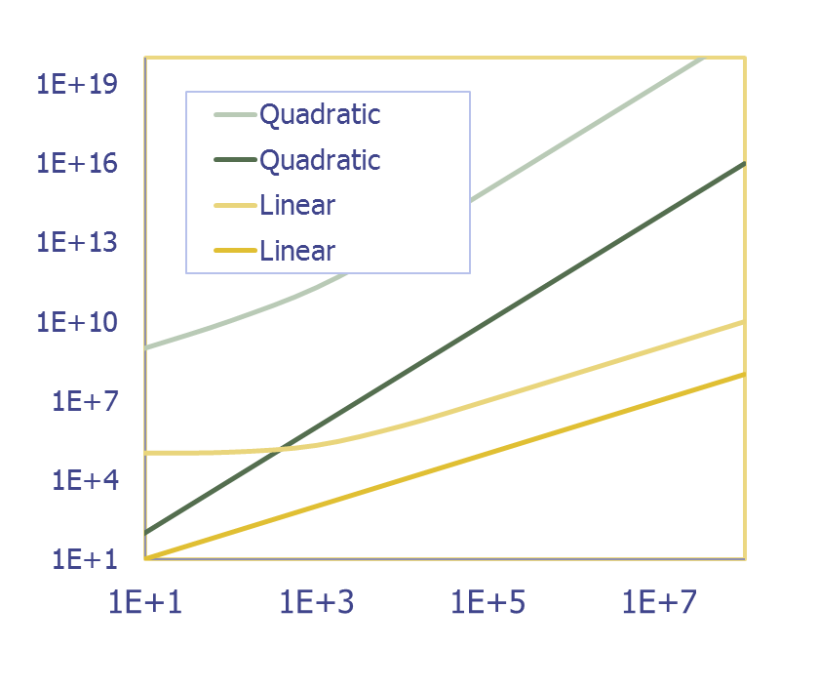
Summarizing Function Growth
For very large inputs, the growth rate of a function becomes less affected by:
constant factors or
lower-order terms
Examples
10⁵n² + 10⁸n and n² both grow with same slope despite differing constants and lower-order terms
10n + 10⁵ and n both grow with same slope as well
Take the x axis as the log term
10⁵n² + 10⁸n
n²
10n + 10⁵
T(n)
n
n
In this graph (log scale on both axes), the slope of a line corresponds to the growth rate of its respective function

Slide 19
Seven Important Functions
Seven functions that often appear in algorithm analysis:
Constant ≈ 1
Logarithmic ≈ log n
Linear ≈ n
N-Log-N ≈ n log n
Quadratic ≈ n²
Cubic ≈ n³
Exponential ≈ 2^{n}
In a log-log chart, the slope of the line corresponds to the growth rate

Slide 20
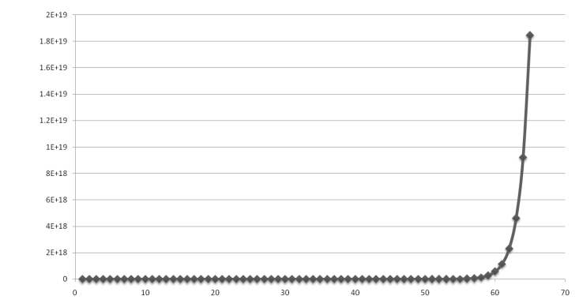
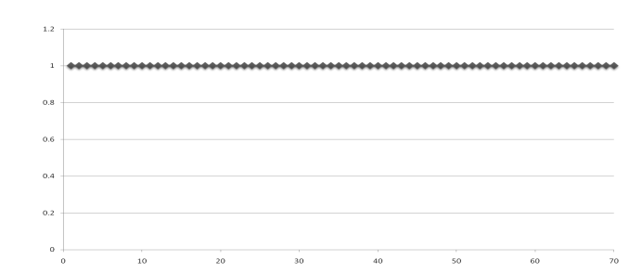
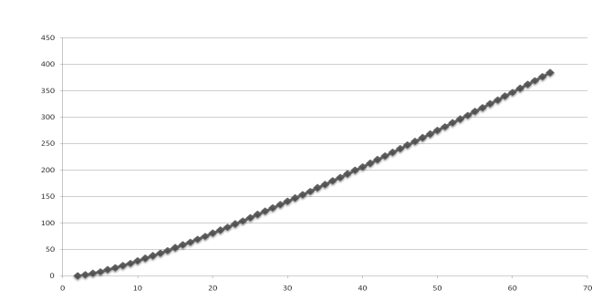
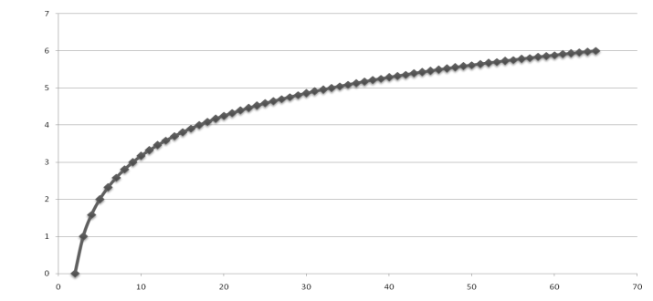
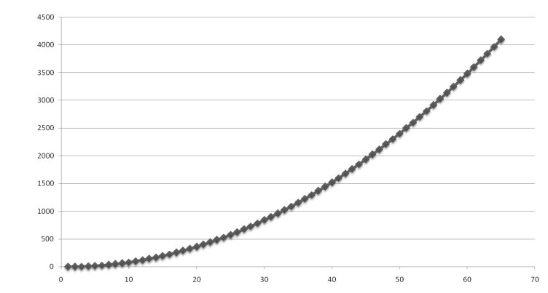
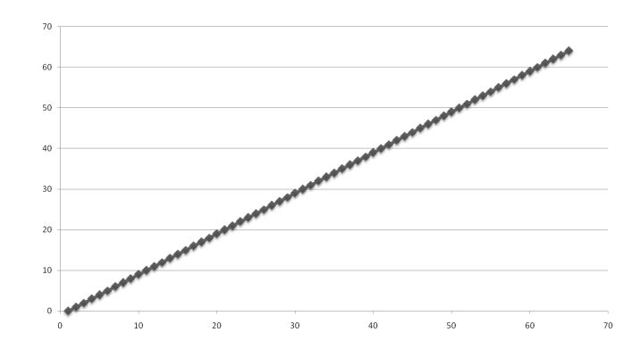
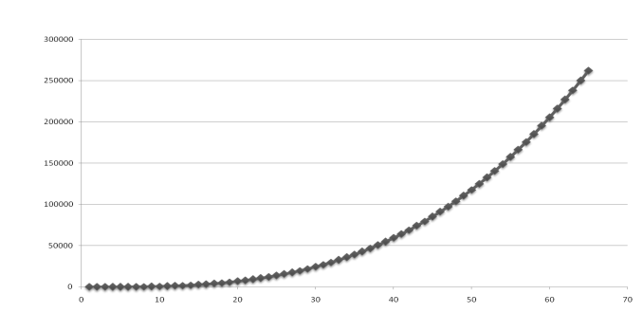
Functions Graphed Using “Normal” Scale
Slide by Matt Stallmann included with permission.
g(n) = n lg n
g(n) = 1
g(n) = 2^{n}
g(n) = n²
g(n) = lg n
g(n) = n
g(n) = n³

Slide 21
Typical Growth Rates

Slide 22
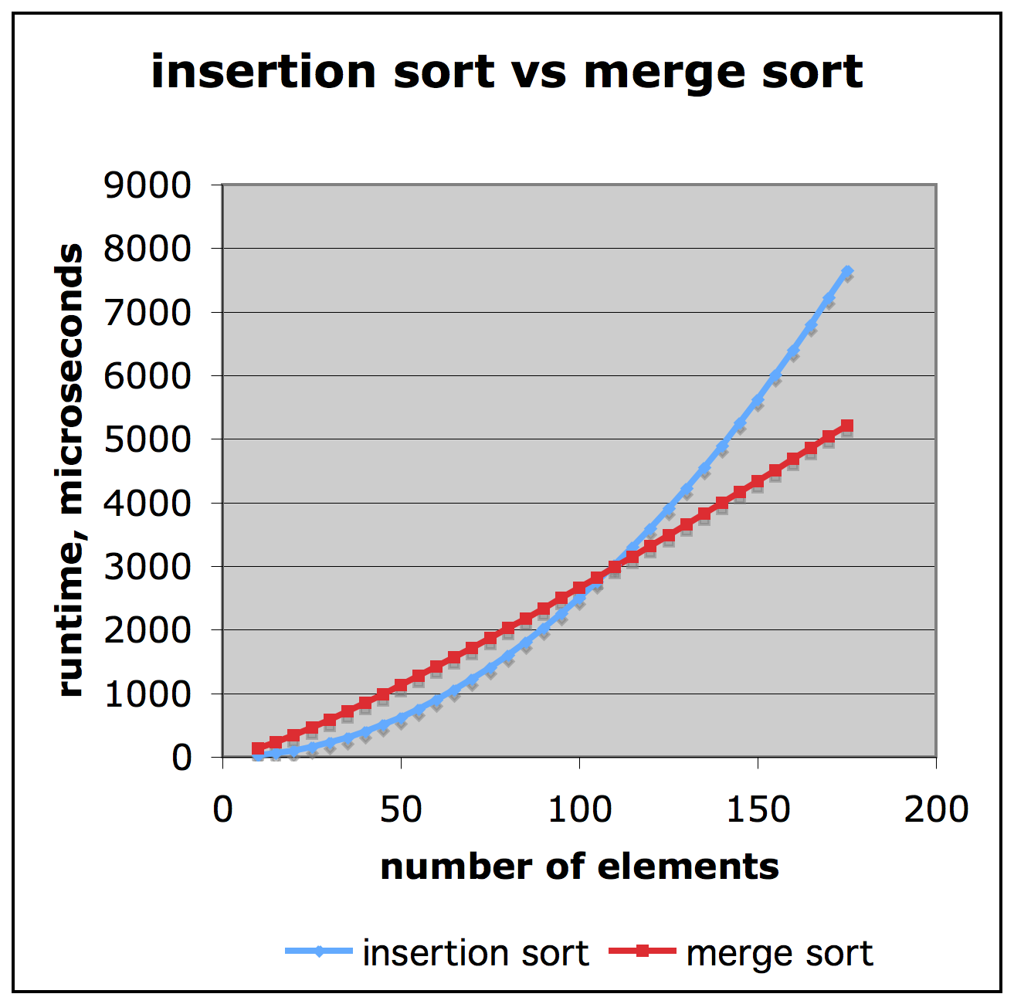
Comparison of Two Algorithms
Slide by Matt Stallmann included with permission.
insertion sort is
n² / 4
merge sort is
2 n lg n
sort a million items?
insertion sort takes
roughly 70 hours
while
merge sort takes
roughly 40 seconds
This is a slow machine, but if
100 x as fast then it’s 40 minutes
versus less than 0.5 seconds

Slide 23
Constant Factors
The growth rate is not affected by
constant factors or
lower-order terms
Examples
10²n + 10⁵ is a linear function
10⁵n² + 10⁸n is a quadratic function

Slide 24
Comparison of Insertion Sort and Python Built In Sort Function
Please go to Brightspace to open the InsertionVSbuiltinClassVersion.py file
Implement Insertion sort in that code.
Use the Python built in sort from list class
Compare the runtime. Which one is better???
Submit code to Gradescope

Slide 25
Insertion Sort
Idea: like sorting a hand of playing cards
Start with an empty left hand and the cards facing down on the table.
Remove one card at a time from the table, and insert it into the correct position in the left hand
compare it with each of the cards already in the hand, from right to left
The cards held in the left hand are sorted
these cards were originally the top cards of the pile on the table
Visualization: https://visualgo.net/en/sorting

Slide 26
Insertion Sort
To insert 12, we need to make room for it by moving first 36 and then 24.
6
10
24
36
12

Slide 27
Insertion Sort
6
10
24
36
12

Slide 28
Insertion Sort
6
10
24
36
12

Slide 29
Insertion Sort
10
12
24
6
36

Slide 30
Insertion Sort
input array
5 2 4 6 1 3
at each iteration, the array is divided in two sub-arrays:
left sub-array
right sub-array
sorted
unsorted

Slide 31
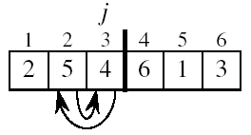
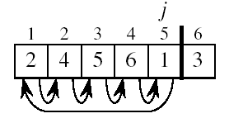
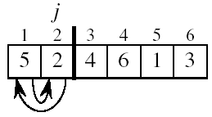
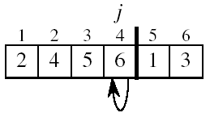
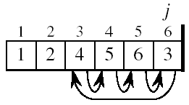
Insertion Sort

Slide 32
INSERTION-SORT
0
1
2
3
4
5
6
7
a₀
a₁
a₂
a₃
a₄
a₅
a₆
a₇
Alg.: INSERTION-SORT(A)
for j ← 1 to n-1
do key ← A[ j ]
# Insert key into the sorted sequence A[0 . . j-1]
i ← j - 1
while i >= 0 and A[i] > key
do A[i + 1] ← A[i]
i ← i – 1
A[i + 1] ← key
Insertion sort – sorts the elements in place
key

Slide 33
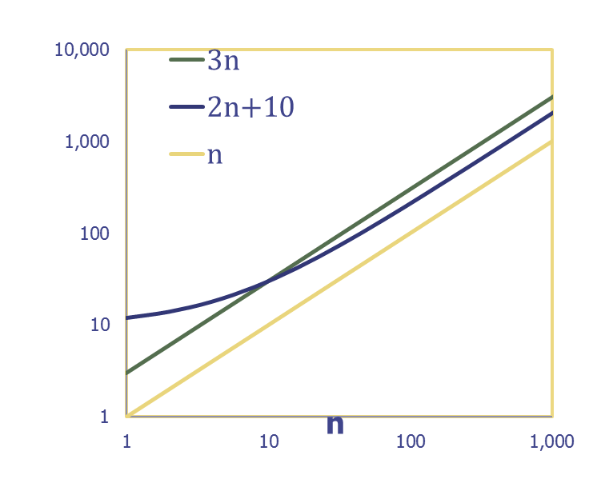
Big-O Notation
Given functions f(n) and g(n), we say that
f(n) is O(g(n))
if there exist positive constants c and n₀ such that
f(n) ≤ c g(n) for all n ≥ n₀
Example: 2n + 10 is O(n)
Pick c = 3 and n₀ = 10
2n + 10 ≤ 3n
2(10) + 10 ≤ 3(10)
30 ≤ 30

Slide 34
Big-O Notation (continued)
Example: n² is not O(n)
n² ≤ cn
n ≤ c
The above inequality cannot be satisfied because c must be a constant, therefore for any n > c the inequality is false

Slide 35
Big-O and Growth Rate
Big-O notation gives an upper bound on the growth rate of a function
We say “an algorithm is O(g(n))” if the growth rate of the algorithm is no more than the growth rate of g(n)
We saw on the previous slide that n² is not O(n)
But n is O(n²)
And n² is O(n³)
Why? Because Big-O is an upper bound!

Slide 36
Summary of Big-O Rules
If f(n) is a polynomial of degree d, then f(n) is O(n^{d}). In other words:
forget about lower-order terms
forget about constant factors
Use the smallest possible degree
It’s true that 2n is O(n⁵⁰), but that’s not a helpful upper bound
Instead, say it’s O(n), discarding the constant factor and using the smallest possible degree

Slide 37
Constants in Algorithm Analysis
Find the number of primitive operations executed as a function (T) of the input size
first: T(n) = 2
argmax: T(n) = 5n + 2
possible_products: T(n) = 5n² + n + 3
In the future we can skip counting operations and replace any constants with c since they become irrelevant as n grows
first: T(n) = c
argmax: T(n) = c₀n + c₁
possible_products: T(n) = c₀n² + n + c₁

Slide 38

Easy to express T in big-O by dropping constants and lower-order terms
In big-O notation
first is O(1)
argmax is O(n)
possible_products is O(n²)
The convention for representing T(n) = c in big-O is O(1).

Slide 39
More Big-Oh Examples
7n-2
7n-2 is O(n)
need c > 0 and n₀ ≥ 1 such that 7n-2 ≤ c•n for n ≥ n₀
this is true for c = 7 and n₀ = 1
3n³ + 20n² + 5
3n³ + 20n² + 5 is O(n³)
need c > 0 and n₀ ≥ 1 such that 3n³ + 20n² + 5 ≤ c•n³ for n ≥ n₀
this is true for c = 4 and n₀ = 21
3 log n + 5
3 log n + 5 is O(log n)
need c > 0 and n₀ ≥ 1 such that 3 log n + 5 ≤ c•log n for n ≥ n₀
this is true for c = 8 and n₀ = 2

Slide 40
Big-Oh and Growth Rate
The big-Oh notation gives an upper bound on the growth rate of a function
The statement “f(n) is O(g(n))” means that the growth rate of f(n) is no more than the growth rate of g(n)
We can use the big-Oh notation to rank functions according to their growth rate
 | f(n) is O(g(n)) | g(n) is O(f(n))
g(n) grows more | Yes | No
f(n) grows more | No | Yes
Same growth | Yes | Yes

Slide 41
Asymptotic Algorithm Analysis
The asymptotic analysis of an algorithm determines the running time in big-Oh notation
To perform the asymptotic analysis
We find the worst-case number of primitive operations executed as a function of the input size
We express this function with big-Oh notation
Example:
We say that algorithm argmax “runs in O(n) time”
Since constant factors and lower-order terms are eventually dropped anyhow, we can disregard them when counting primitive operations

Slide 42
Computing Prefix Averages
We further illustrate asymptotic analysis with two algorithms for prefix averages
The i-th prefix average of an array X is average of the first (i + 1) elements of X:
A[i] = (X[0] + X[1] + … + X[i])/(i+1)
Computing the array A of prefix averages of another array X has applications to financial analysis

Slide 43
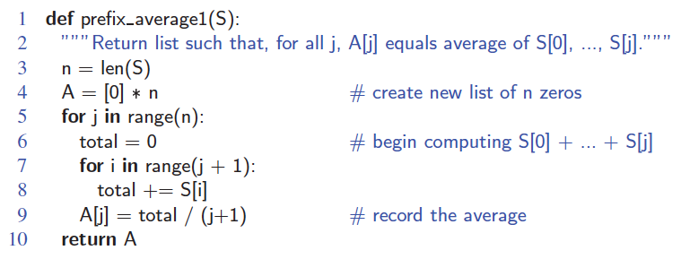
Prefix Averages (Quadratic)
The following algorithm computes prefix averages in quadratic time by applying the definition

Slide 44
Arithmetic Progression
The running time of prefixAverage1 is O(1 + 2 + …+ n)
The sum of the first n integers is n(n + 1) / 2
There is a simple visual proof of this fact
Thus, algorithm prefixAverage1 runs in O(n²) time

Slide 45
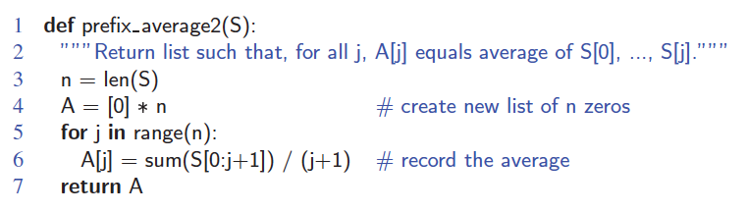
Prefix Averages 2 (Looks Better)
The following algorithm uses an internal Python function to simplify the code
Algorithm prefixAverage2 still runs in O(n²) time!

Slide 46
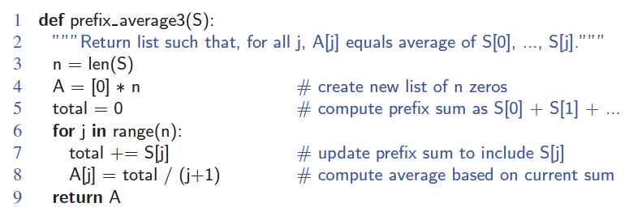
Prefix Averages 3 (Linear Time)
The following algorithm computes prefix averages in linear time by keeping a running sum
Algorithm prefixAverage3 runs in O(n) time

Slide 47
Math you need to Review
Summations
Logarithms and Exponents
Proof techniques
Basic probability
properties of logarithms:
log_{b}(xy) = log_{b}x + log_{b}y
log_{b} (x/y) = log_{b}x - log_{b}y
log_{b}xª = alog_{b}x
log_{b}a = log_{x}a/log_{x}b
properties of exponentials:
a^{(b+c)} = a^{b}a ^{c}
a^{bc} = (a^{b})^{c}
a^{b} /a^{c} = a^{(b-c)}
b = a ^{log}_{a}^{b}
b^{c} = a ^{c*log}_{a}^{b}

Slide 48
Composition Rules for Big-O
If T₁(N) = O(f(N)) and T₂(N) = O(g(N))
T₁(N) + T₂(N) = O(f(N)) + O(g(N))
O(max(f(N), g(N))
T₁(N) * T₂(N) = O(f(N)) * O(g(N))

Slide 49
General Rules – Basic for-loops
def sum(n):
partialSum = 0
for i in range(1,n+1):
partialSum += i*i*i
return partialSum

Slide 50
General Rules – Nested Loops
for i in range(n):
for j in range(n):
k += 1

Slide 51
General Rules – Consecutive Blocks
for i in range(n):
a[i] = 0
for i in range(n):
for j in range(n):
a[i] += a[j] + i + j

Slide 52
General Rules - Conditionals
if condition:
S1
else:
S2

Slide 53
Logarithms in the Runtime
def binarySearch(a, x):
low = 0
high = len(a) – 1
while low <= high:
mid = (low+high) // 2
if a[mid] < x:
low = mid+1
elif a[mid] > x:
high = mid-1
else:
return mid #found
return -1 #not found
Reduces the search space by half at every step
k steps until N+1 ≥ 2^{k} ≥ N
Log₂(N+1) ≥ k ≥ Log₂N
T(N) = O(Log(N))

Slide 54
In-class exercise
Please complete the in-class Big-O exercises on Gradescope.
Notes:
O(log n)

Slide 55
Big-Omega (Ω)
Recall that f(n) is O(g(n)) if f(n) ≤ cg(n) for some constant c as n grows
Big-O expresses the idea that f(n) grows no faster than g(n)
g(n) acts as an upper bound to f(n)’s growth rate
What if we want to express a lower bound?
We say f(n) is Ω(g(n)) if f(n) ≥ cg(n)
f(n)grows no slower than g(n)
Big-Omega

Slide 56
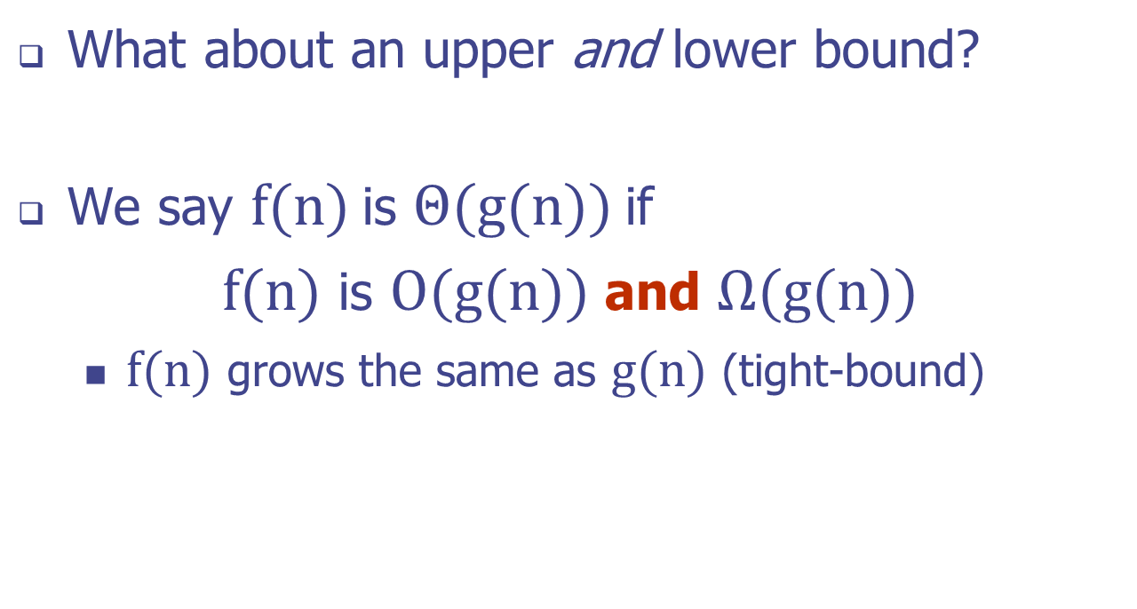
Big-Theta (Θ)
Big-Theta

Slide 57
Some More Examples
Function, f(n) | Big-Θ
an + b | Θ(n)
an² + bn + c | Θ(n²)
a | Θ(1)
3^{n} + an⁴⁰ | Θ(3^{n})
an + b log n | Θ(n)

Slide 58
Common Time Complexities
Name | Running Time
Constant | O(1)
Log-logarithmic | O(log log N)
Logarithmic | O(log N)
Polylogarithmic | O((log N)²)
Fractional power | O(N^{c}) where 0 < c < 1
Linear | O(N)
Linearithmic | O(N log N)
Quadratic | O(N²)
Cubic | O(N³)
Polynomial | O(N^{c}) where c > 3
Exponential | O(c^{N}) where c ≥ 2
Factorial | O(N!)
source: https://en.wikipedia.org/wiki/Time_complexity#Table_of_common_time_complexities

Slide 59
Relatives of Big-Oh
big-Omega
f(n) is Ω(g(n)) if there is a constant c > 0
and an integer constant n₀ ≥ 1 such that
f(n) ≥ c•g(n) for n ≥ n₀
big-Theta
f(n) is Θ(g(n)) if there are constants c’ > 0 and c’’ > 0 and an integer constant n₀ ≥ 1 such that c’•g(n) ≤ f(n) ≤ c’’•g(n) for n ≥ n₀
Notes:
Big-O: upper-bound (may be loose)
Big-Omega: lower-bound (may be loose)
Big-Theta: tight bound

